Slide 1
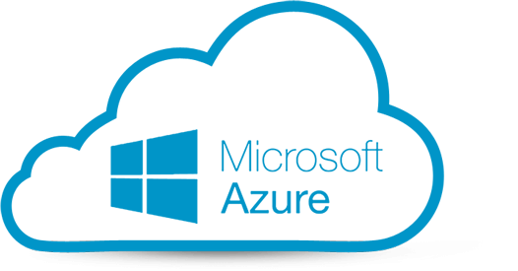
Hand on Lab I: Microsoft Azure
Registrasi Microsoft Azure
Portal Microsoft Azure
Virtual Machine

Slide 2
Microsoft Azure
Registrasi account
https://login.live.com
https://azure.microsoft.com/en-us/free/students/
https://azure.microsoft.com

Slide 3
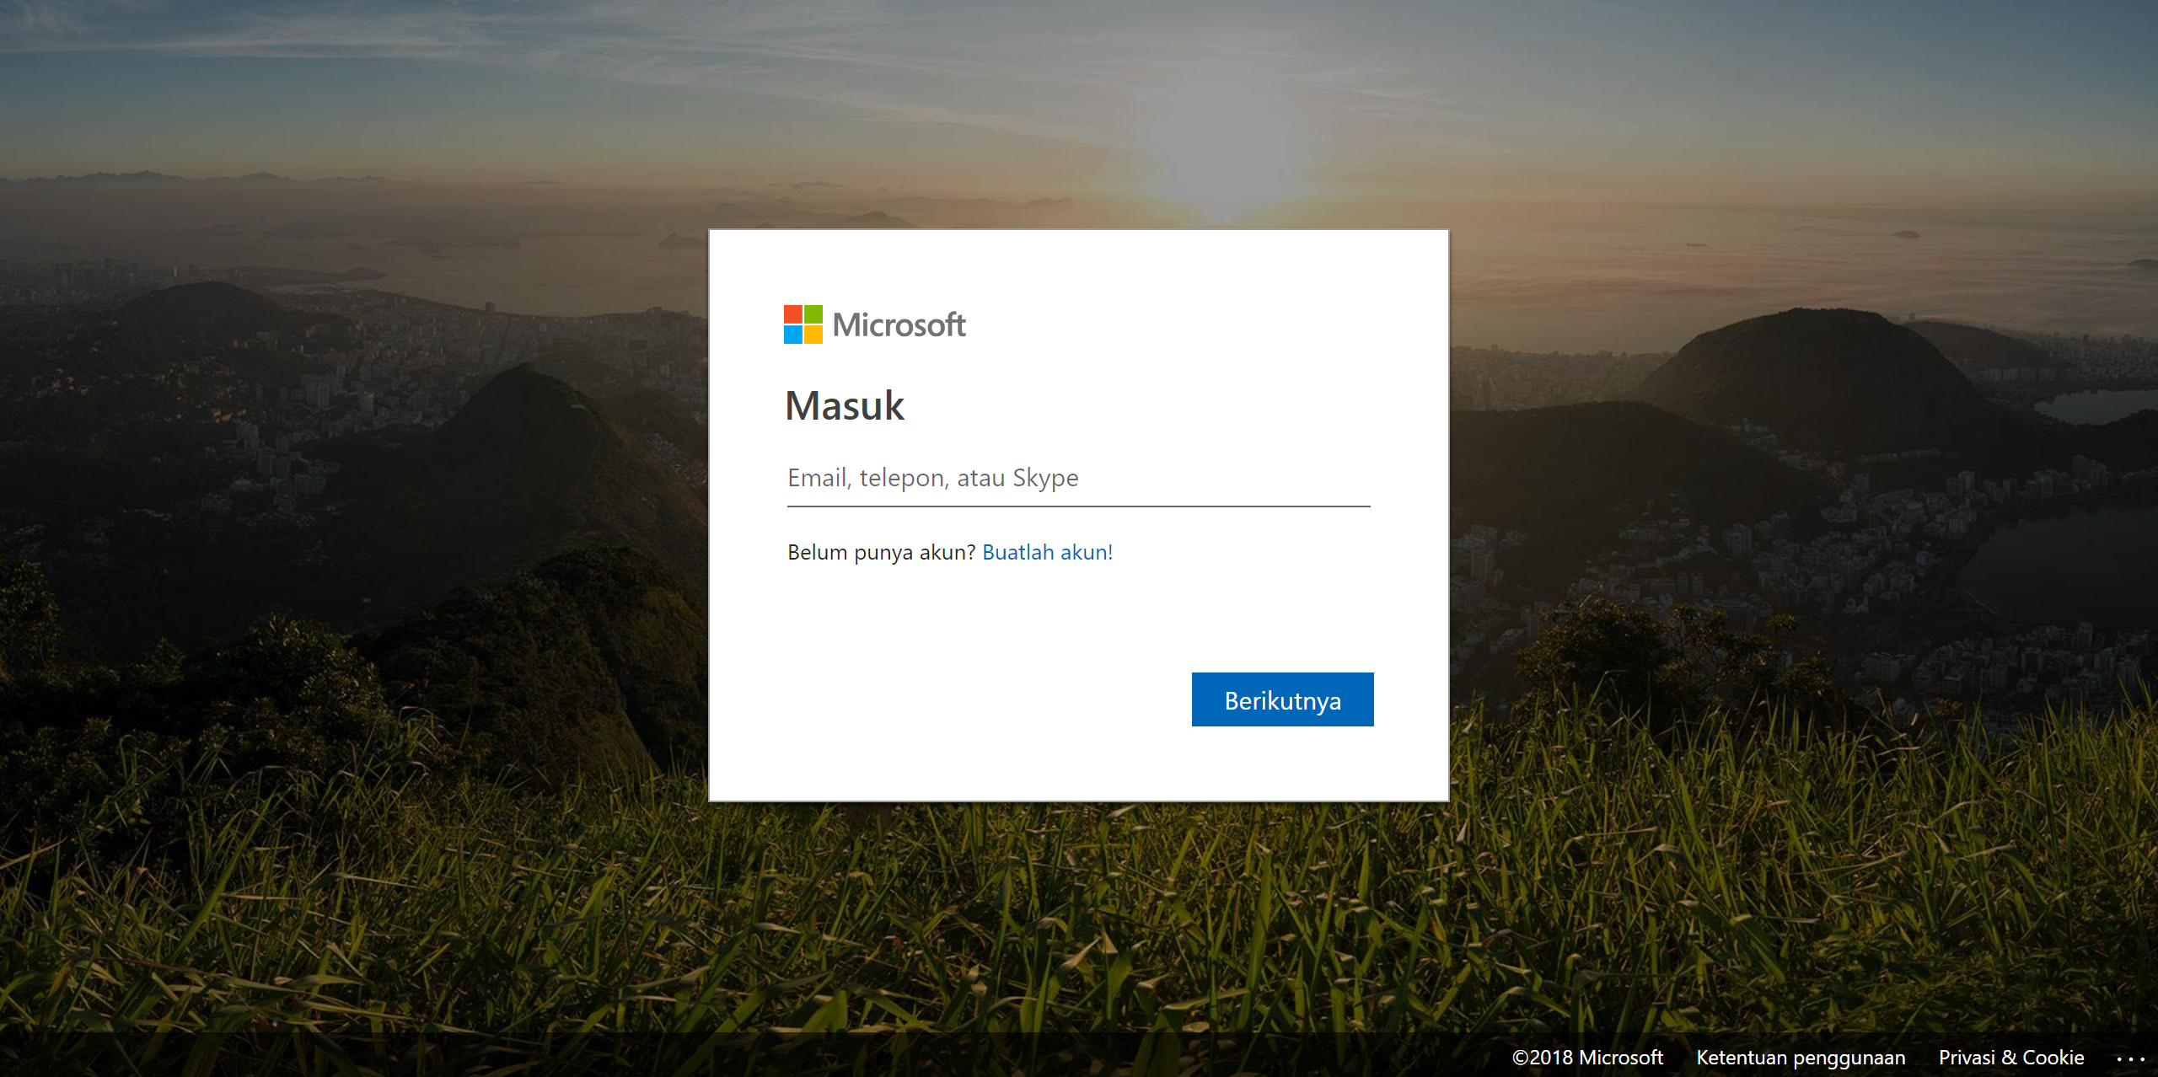
https://login.live.com

Slide 4
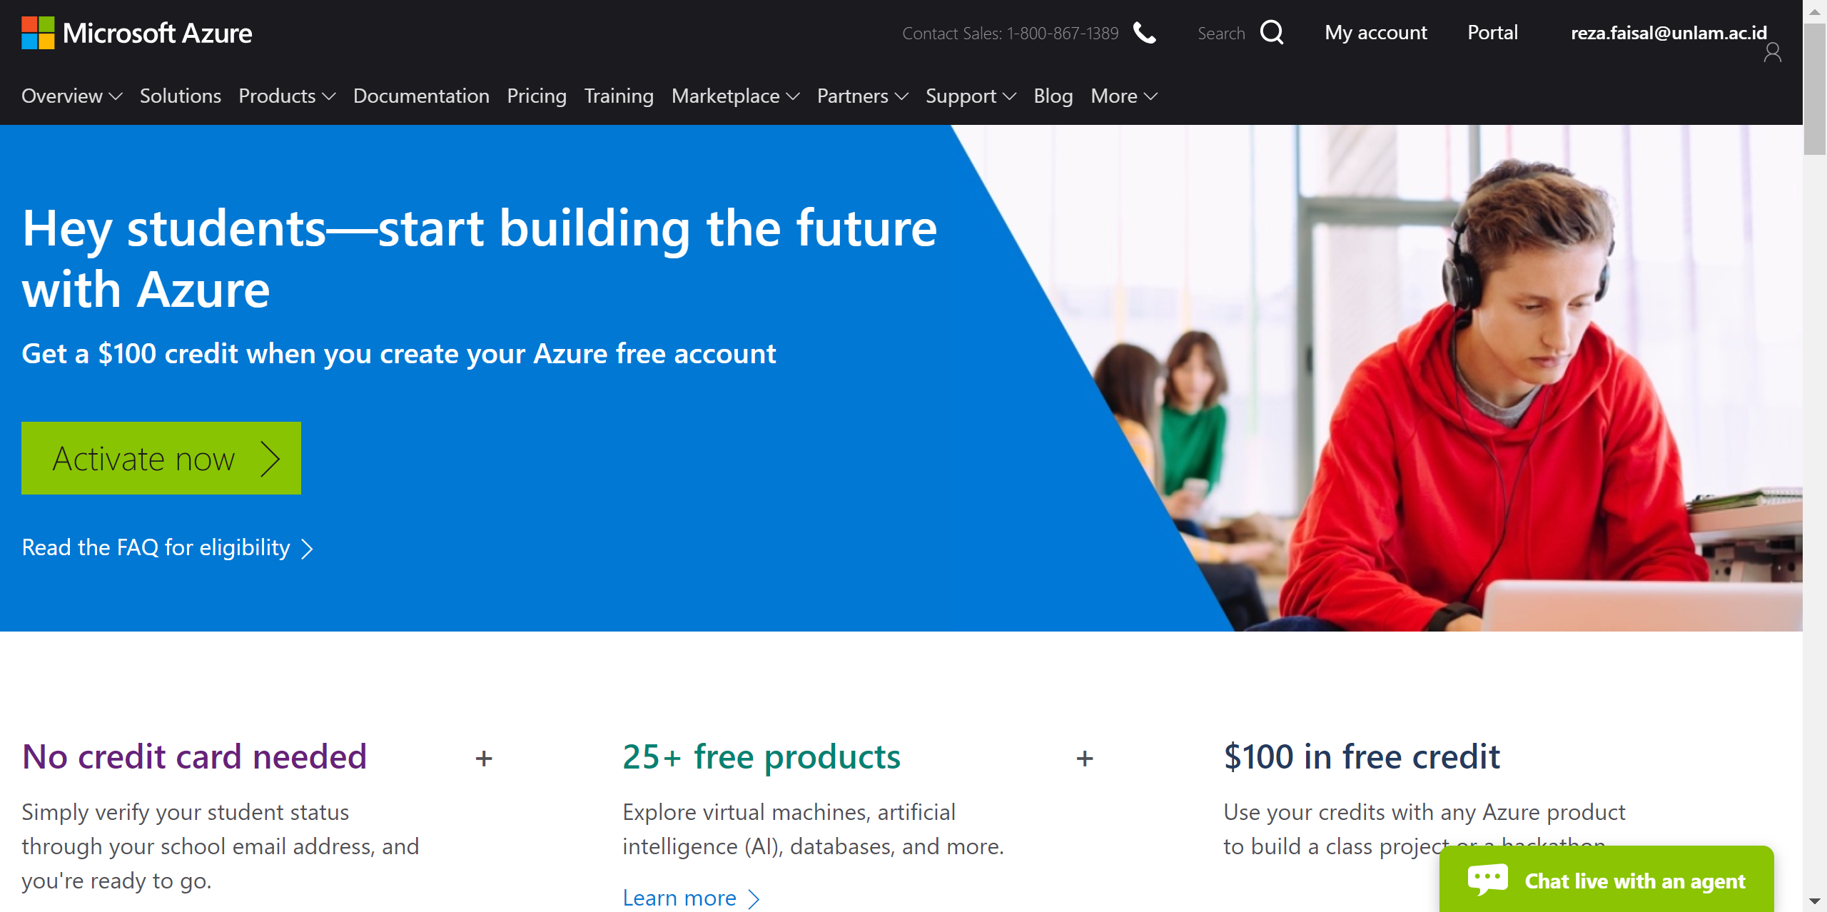
https://azure.microsoft.com/en-us/free/students/

Slide 5
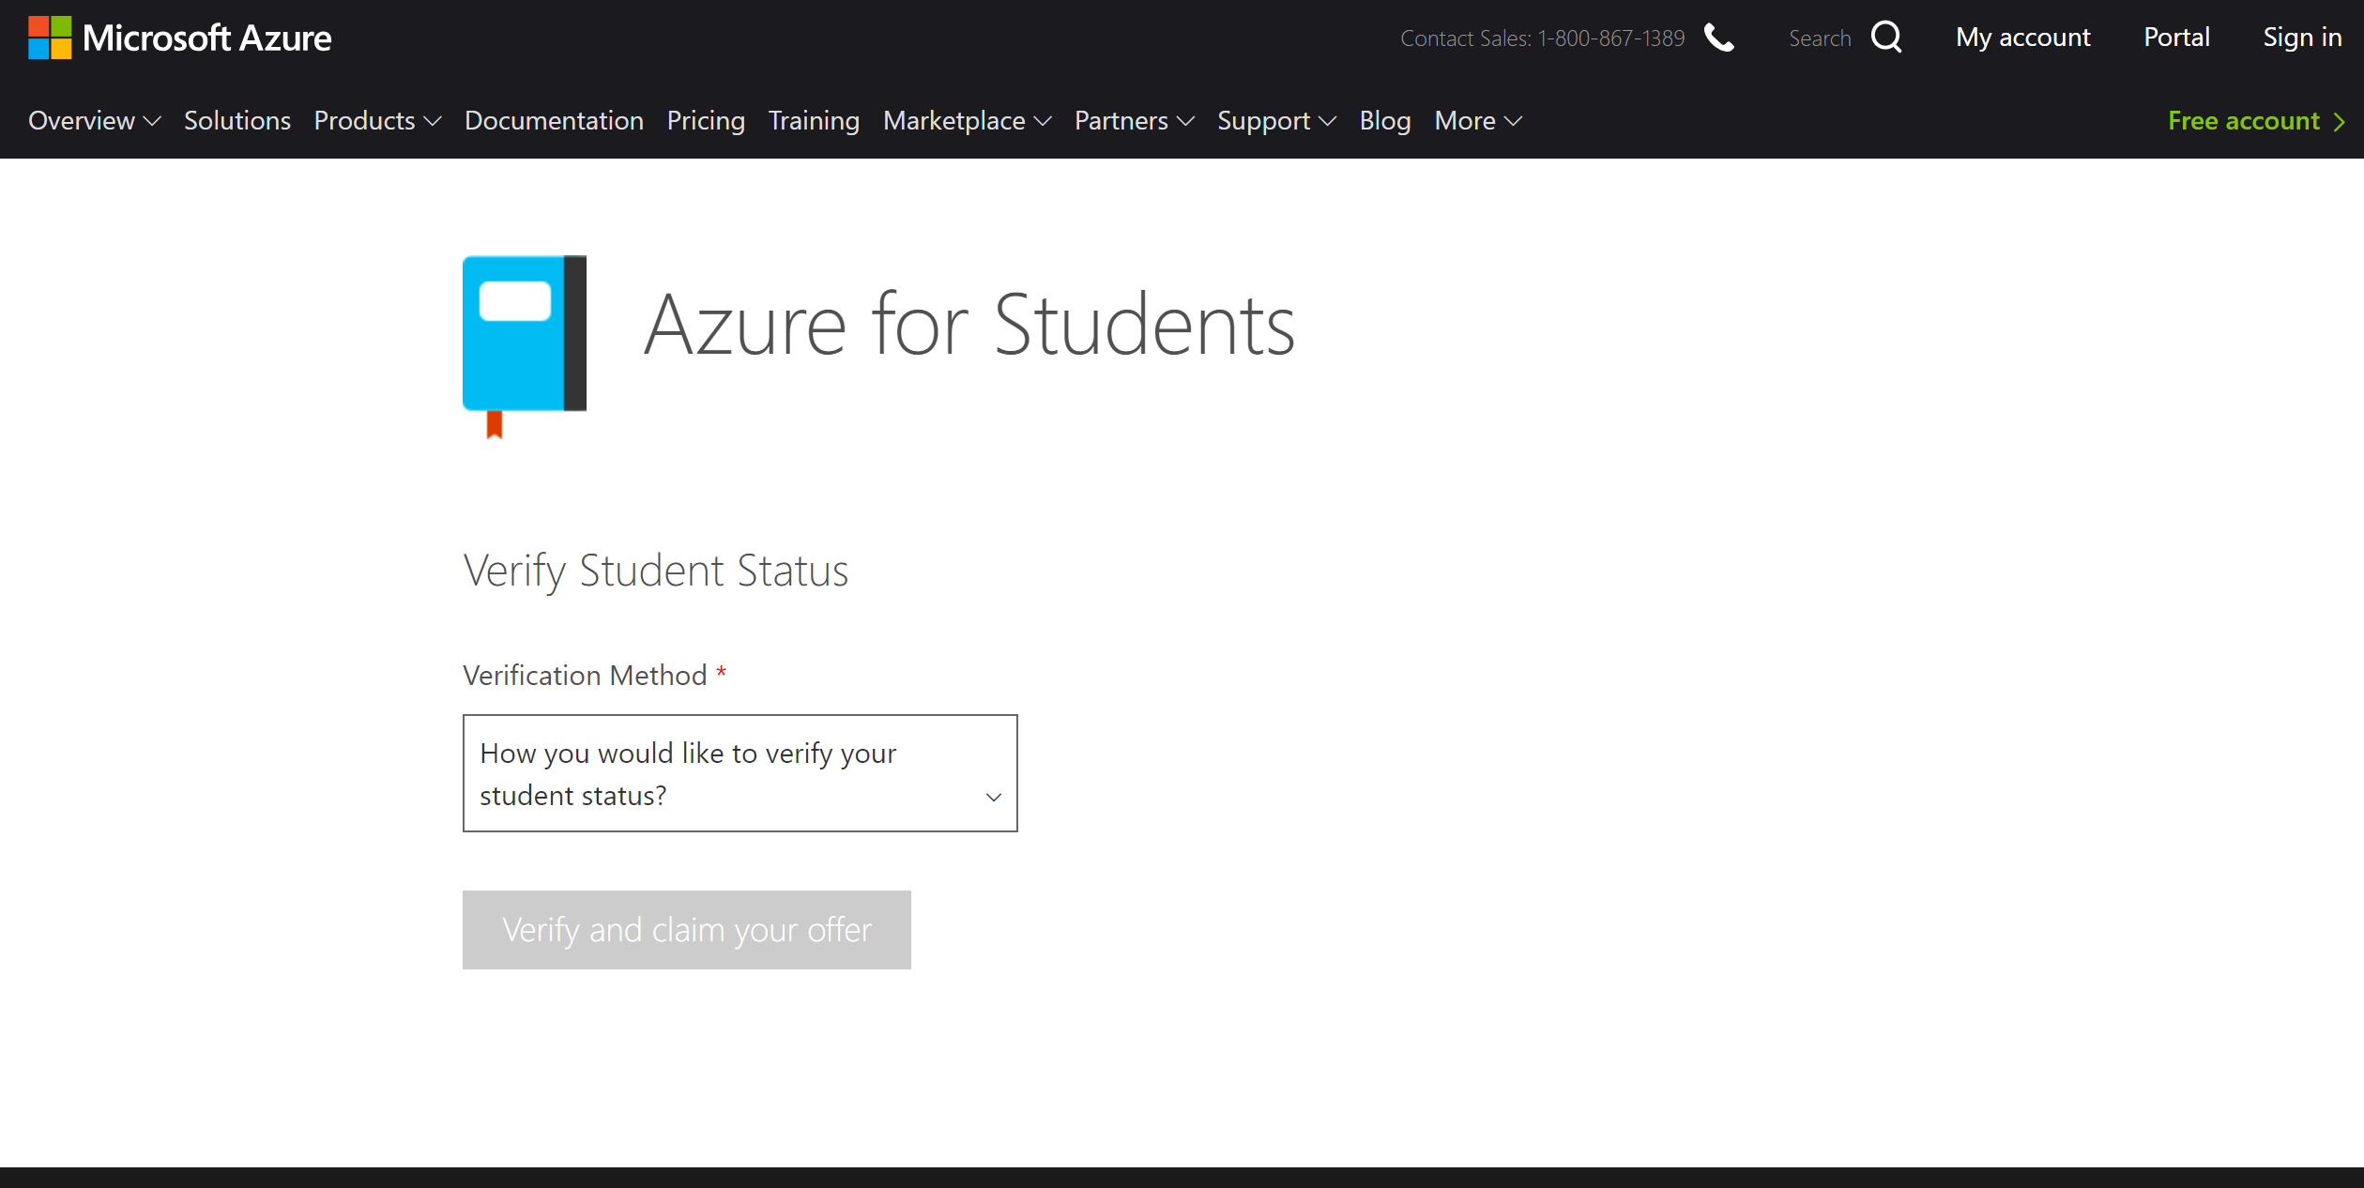

Slide 6
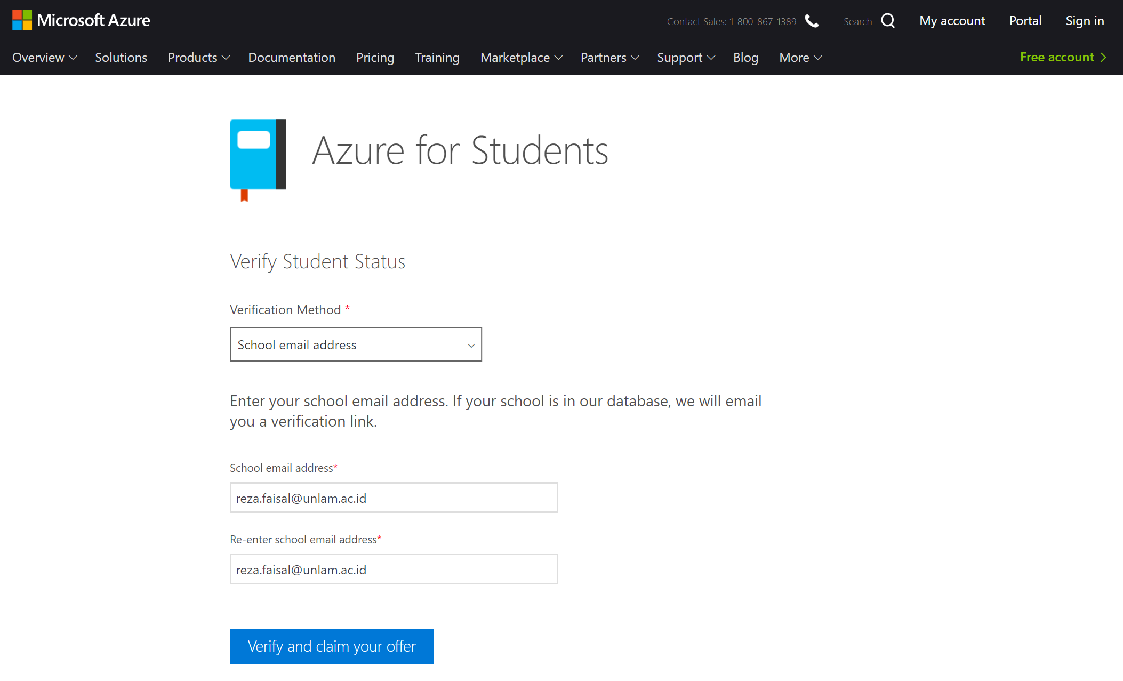

Slide 7
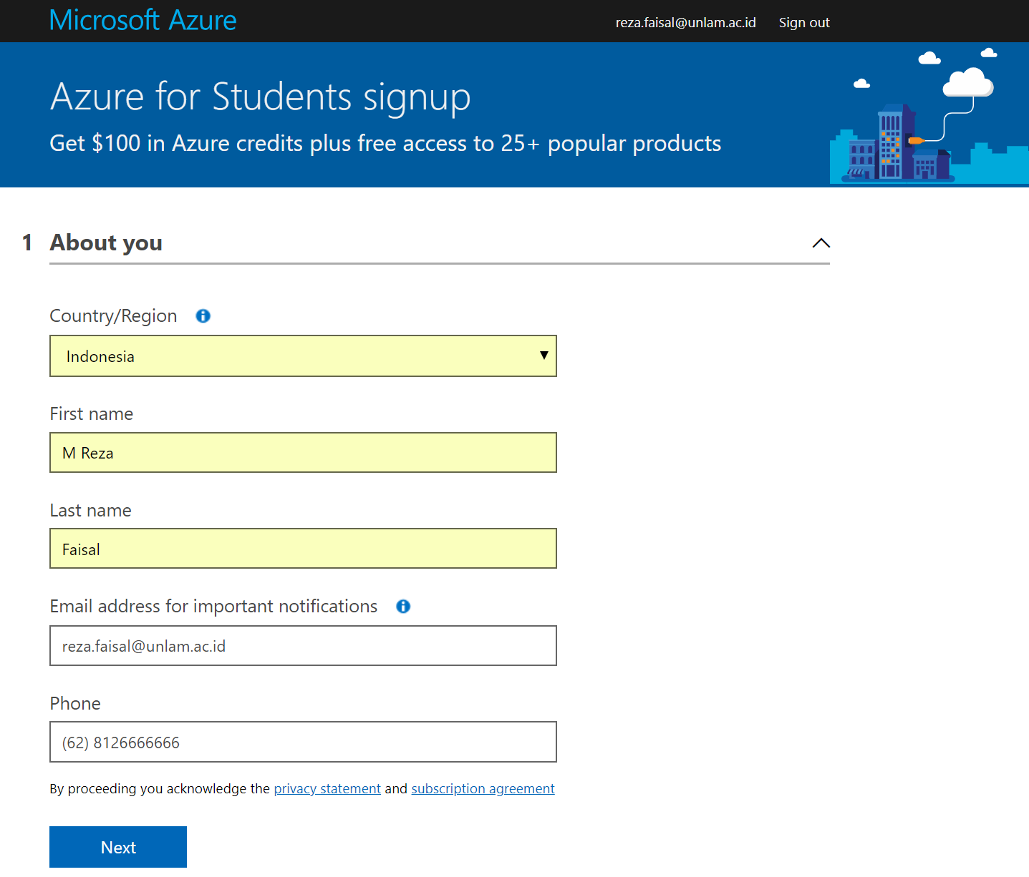

Slide 8
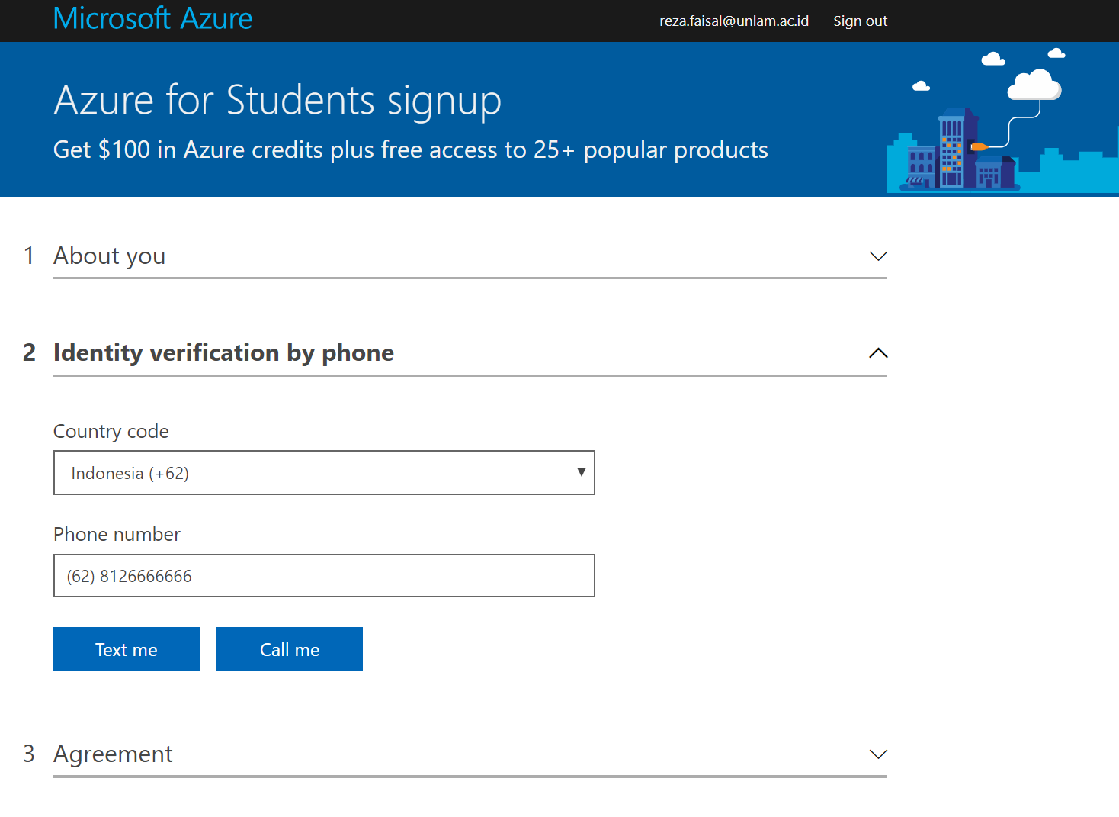

Slide 9
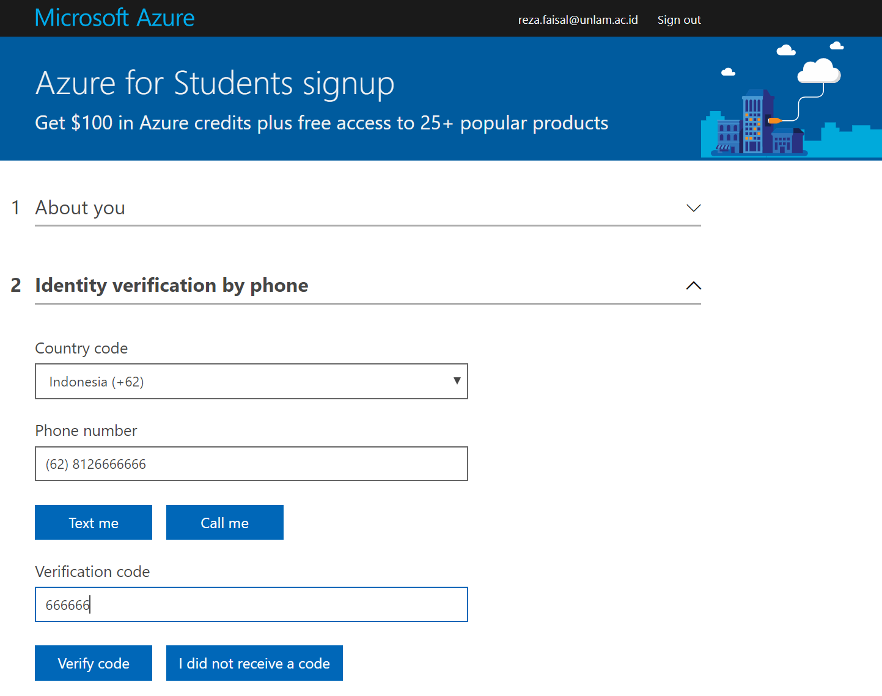

Slide 10
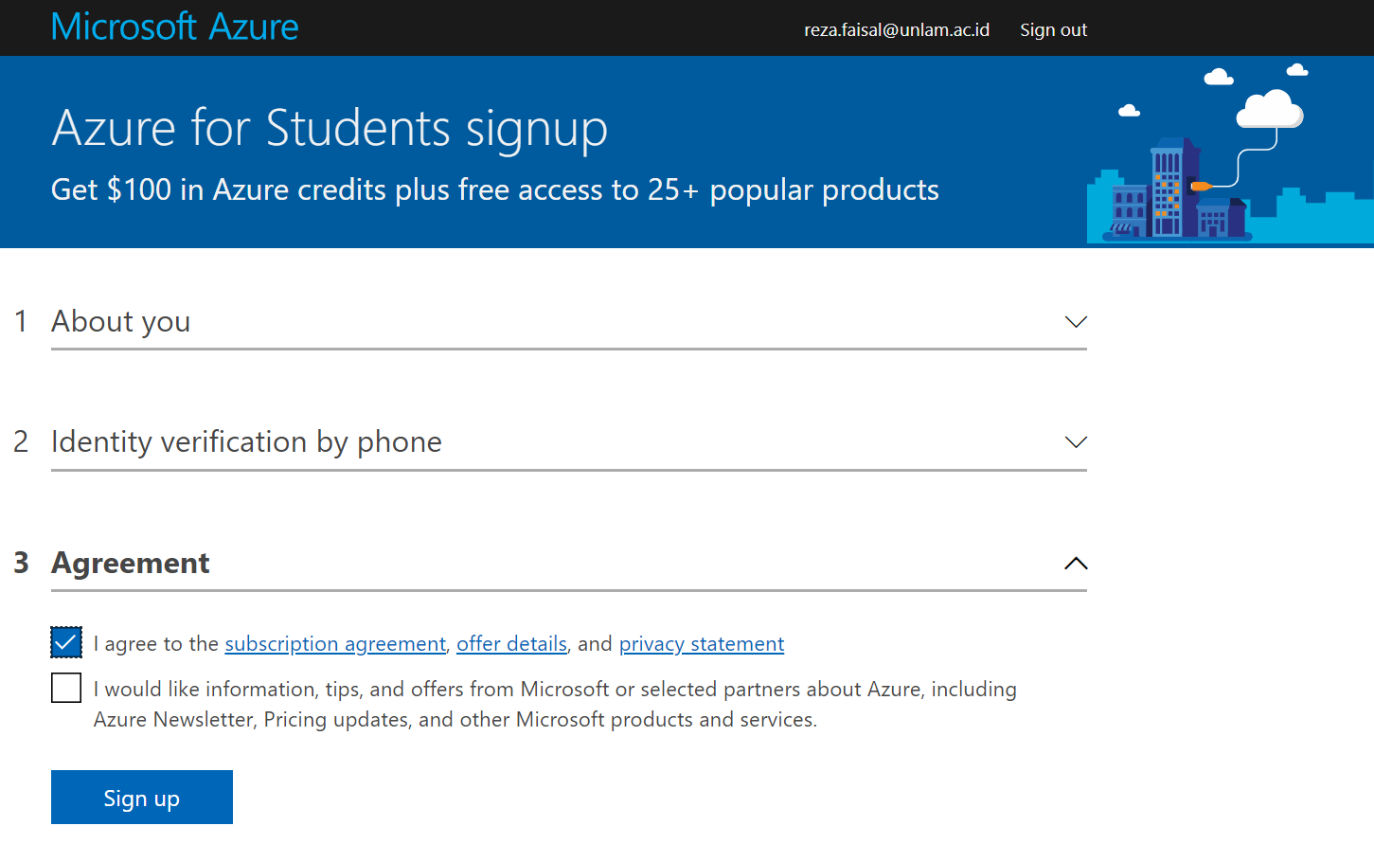

Slide 11
Portal
Eksplorasi layanan cloud computing pada Portal Azure
IaaS
PaaS
SaaS
Membuat Virtual Machine (Total 4 core)
Windows
Linux
Akses Virtual Machine

Slide 12
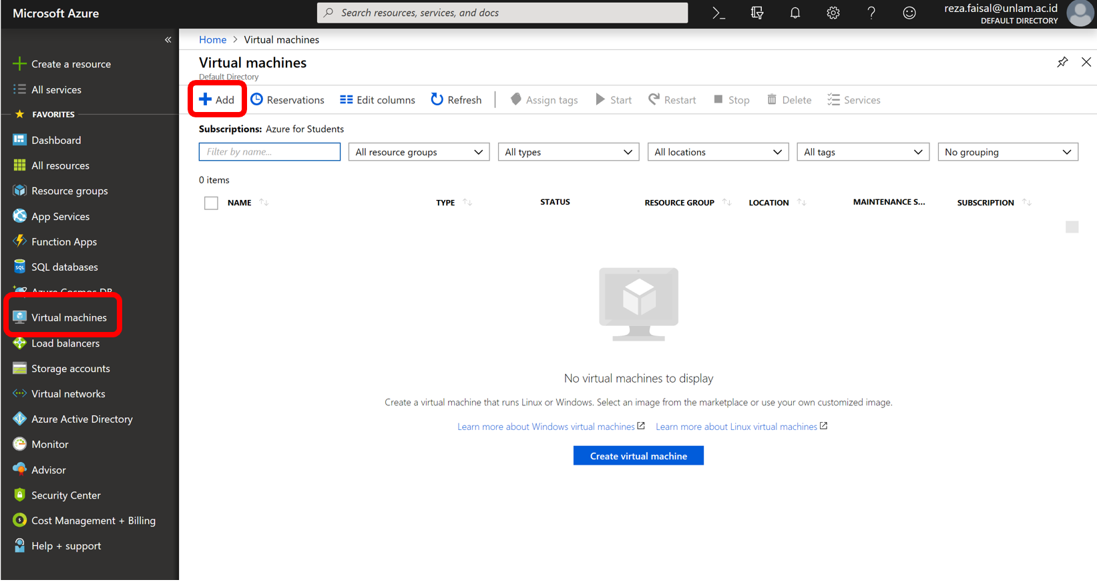
Create Windows Virtual Machine 1/5

Slide 13
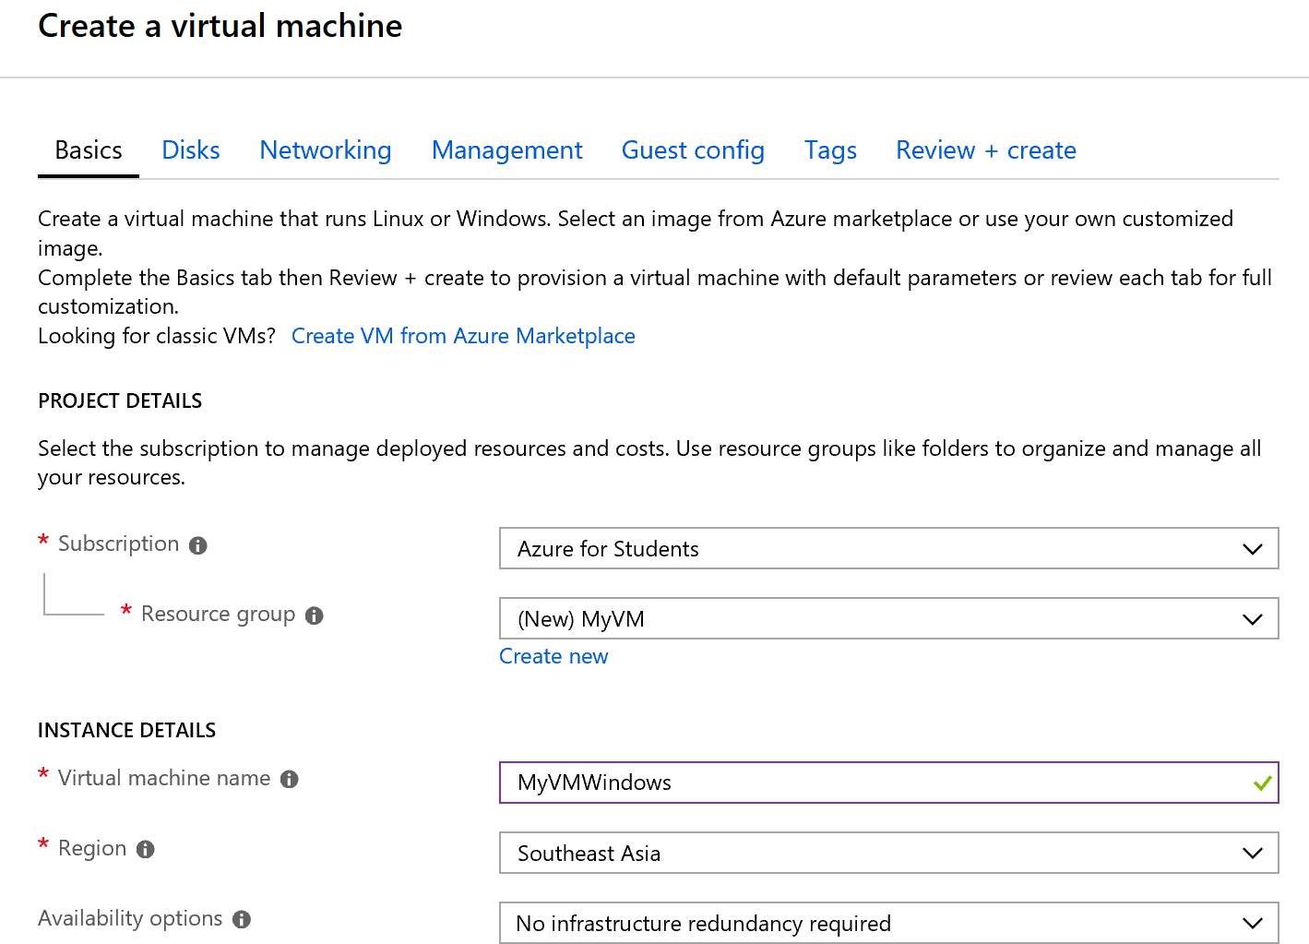
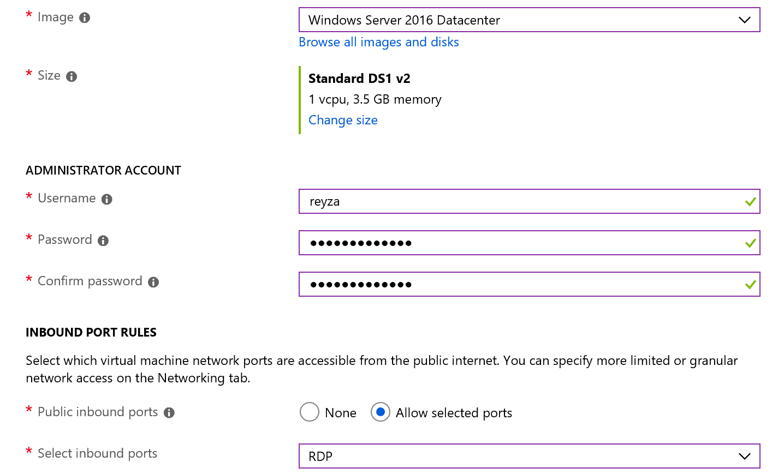
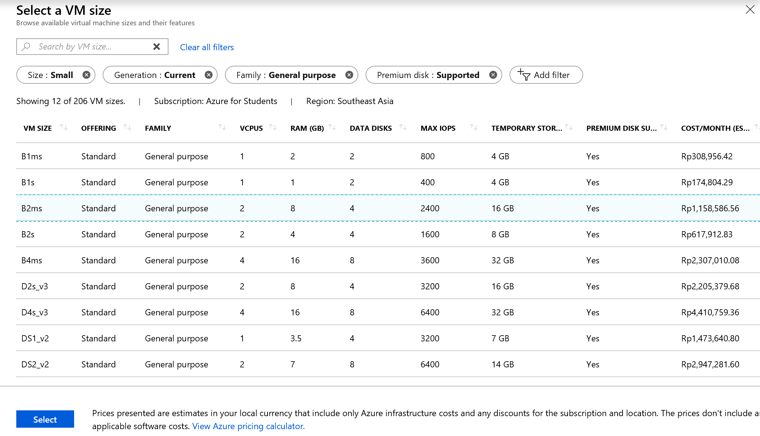
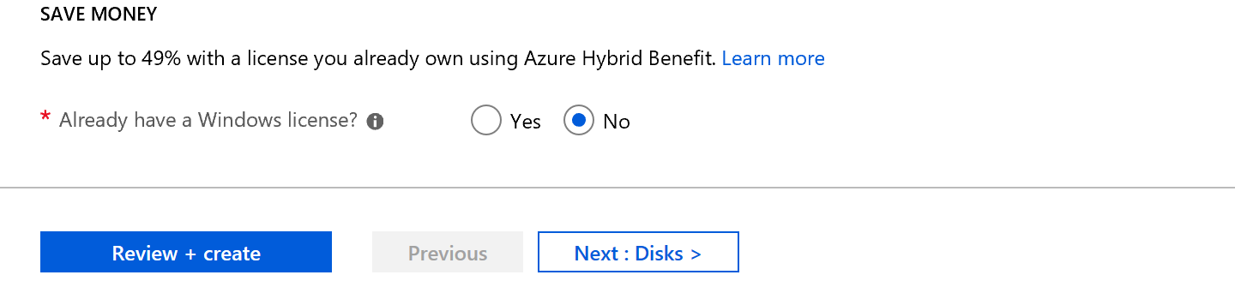
Create Windows Virtual Machine 2/5

Slide 14
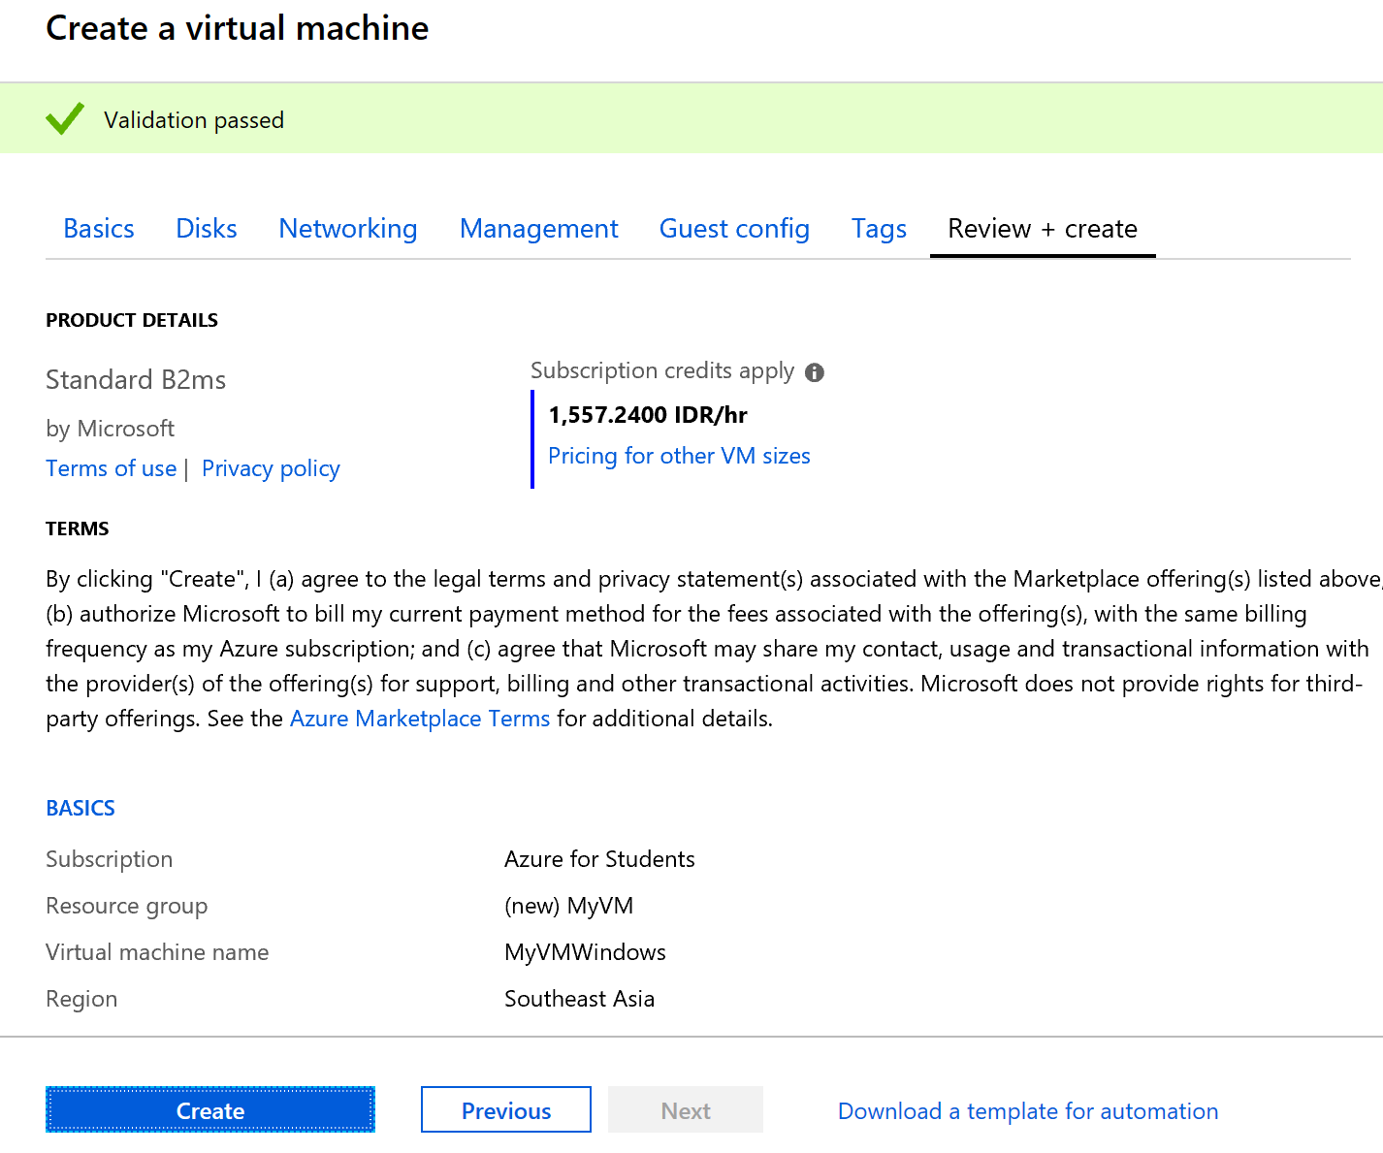
Create Windows Virtual Machine 3/5

Slide 15
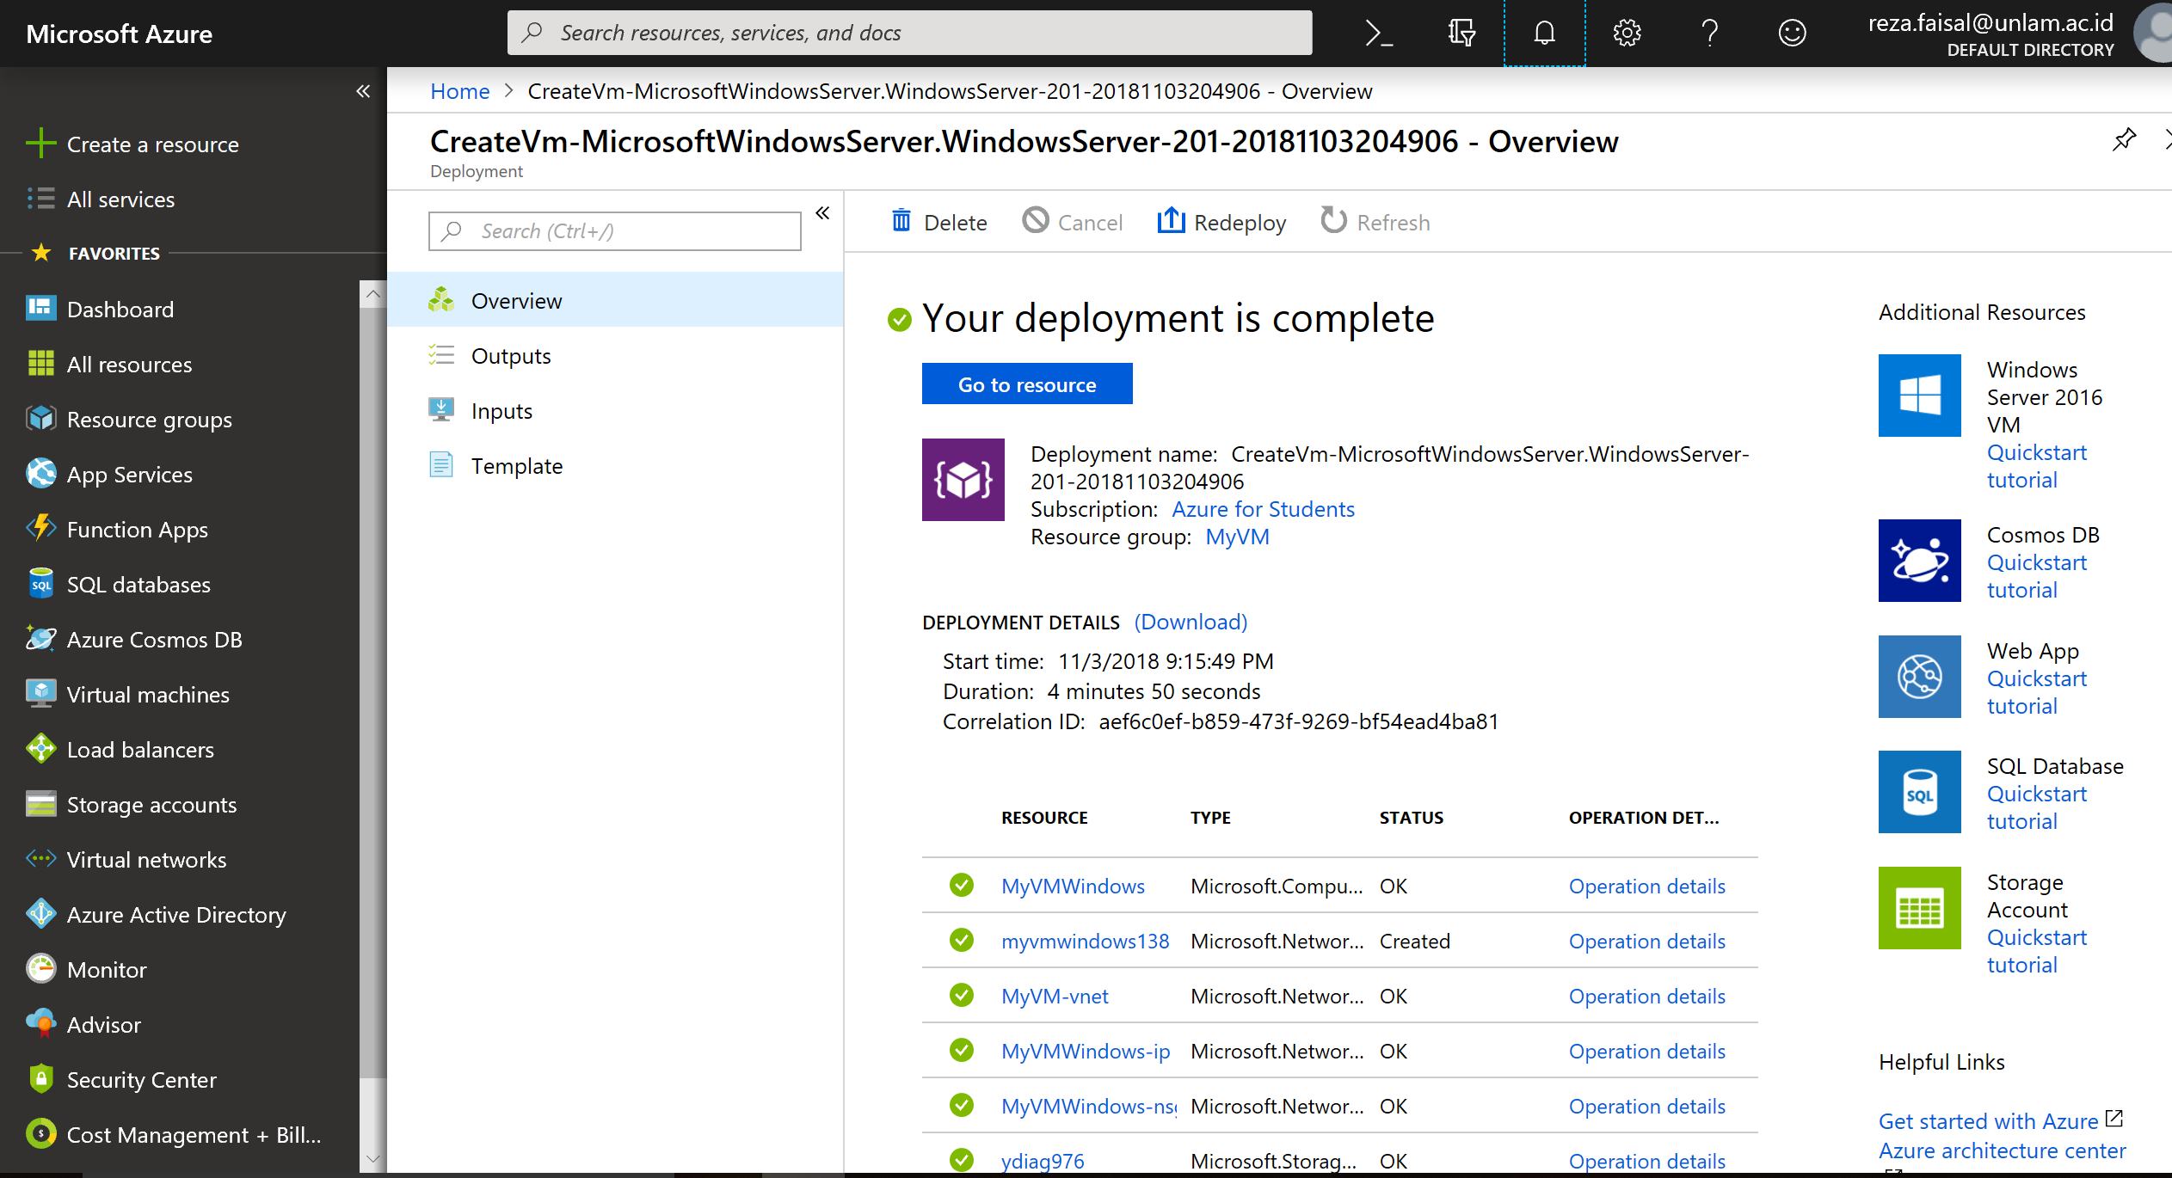
Create Windows Virtual Machine 4/5

Slide 16
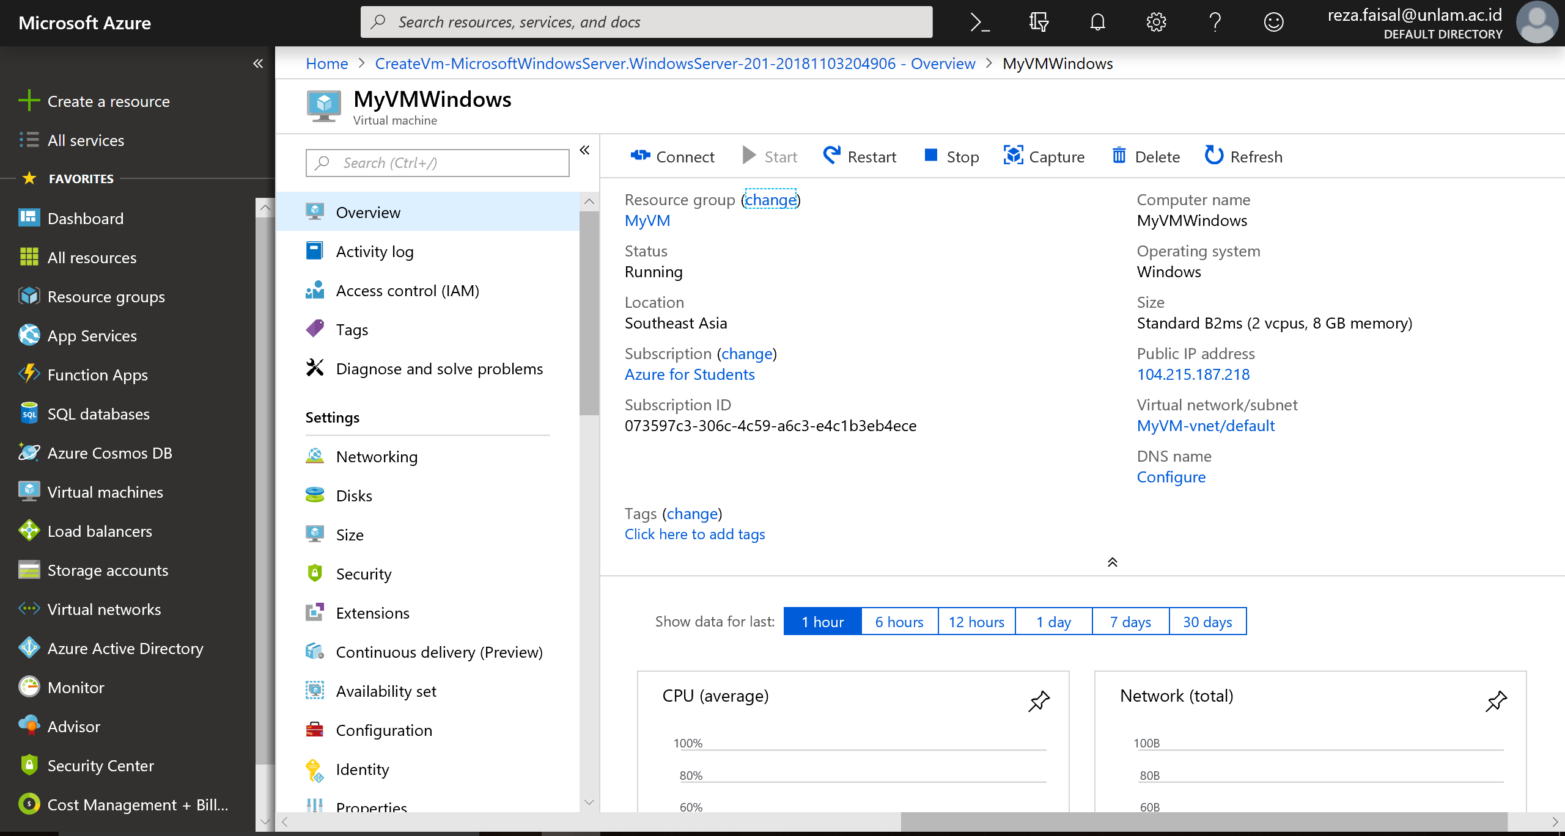
Create Windows Virtual Machine 5/5

Slide 17
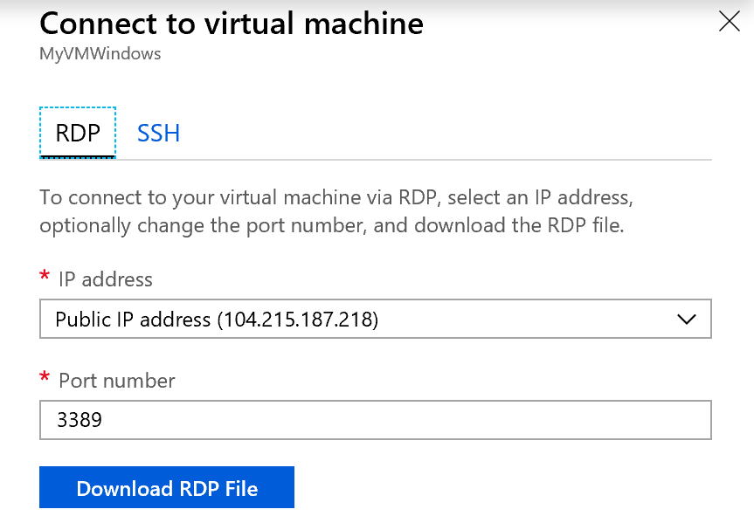
Remote Desktop Windows VM 1/4

Slide 18
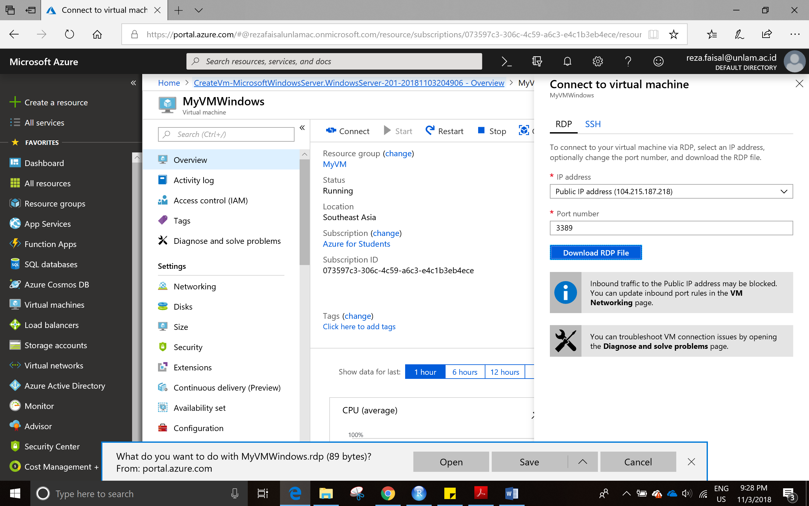
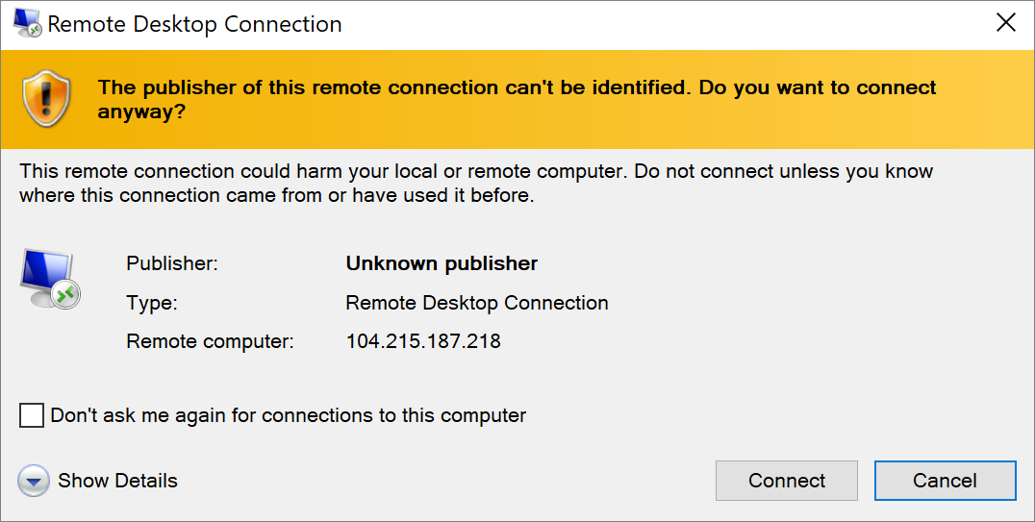
Remote Desktop Windows VM 2/4

Slide 19
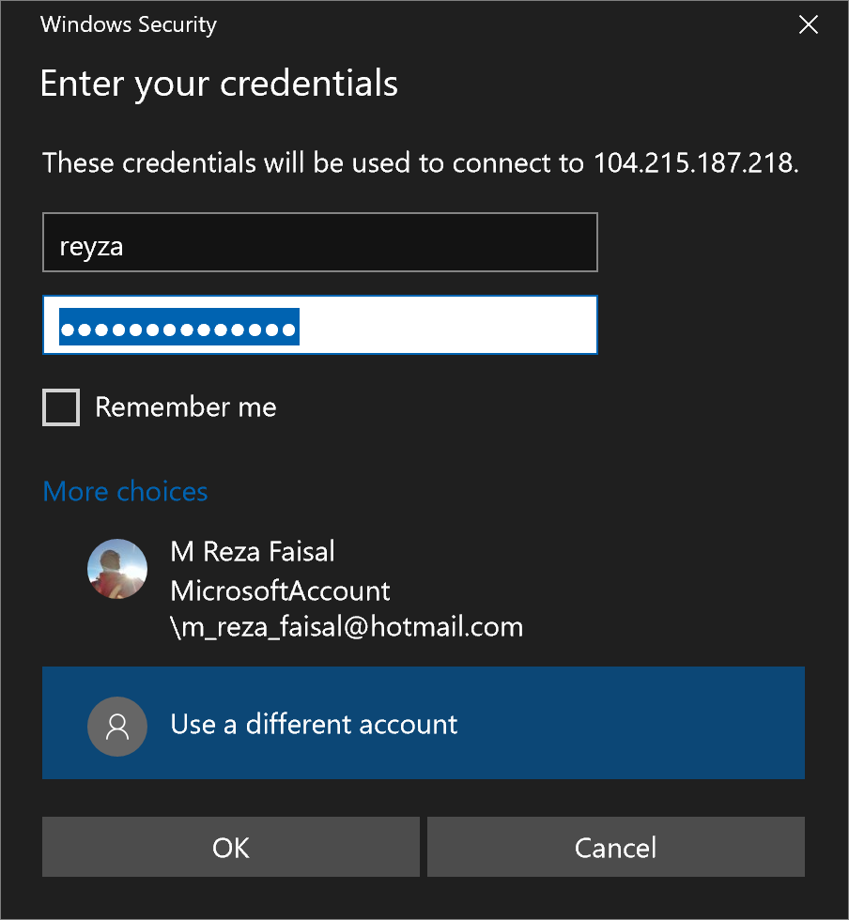
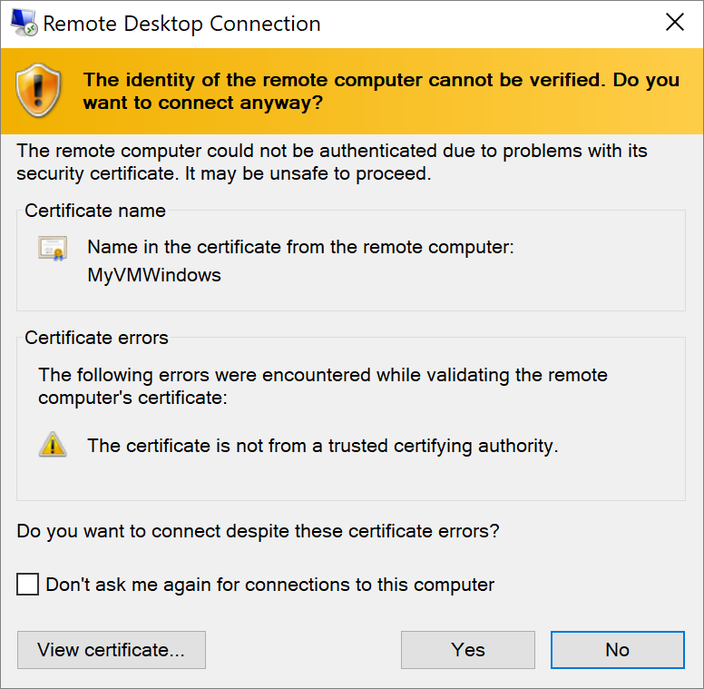
Remote Desktop Windows VM 3/4

Slide 20
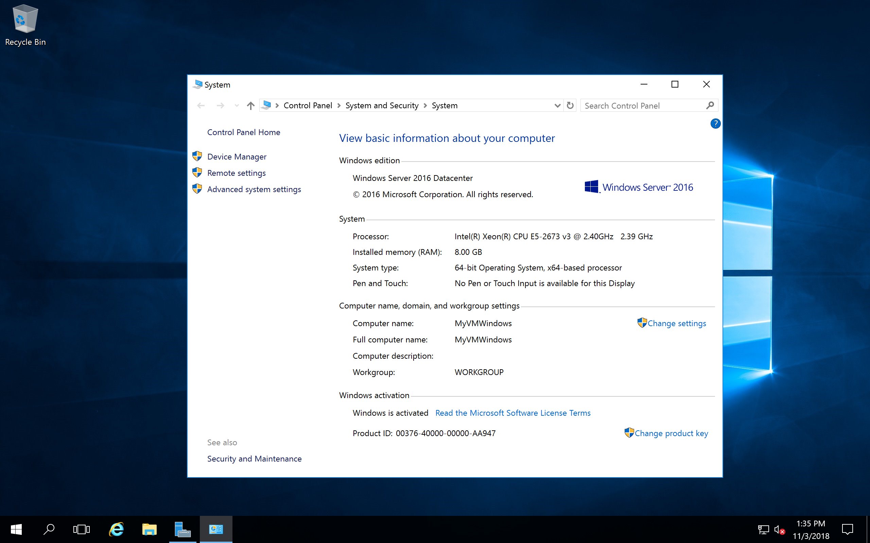
Remote Desktop Windows VM 4/4

Slide 21
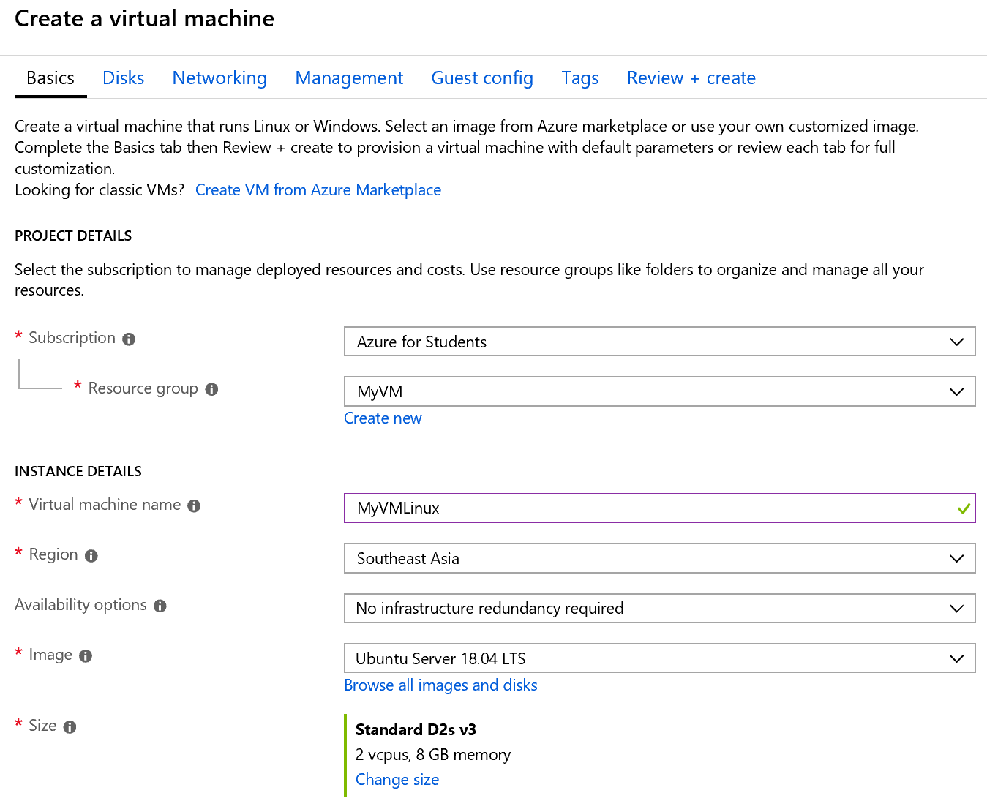
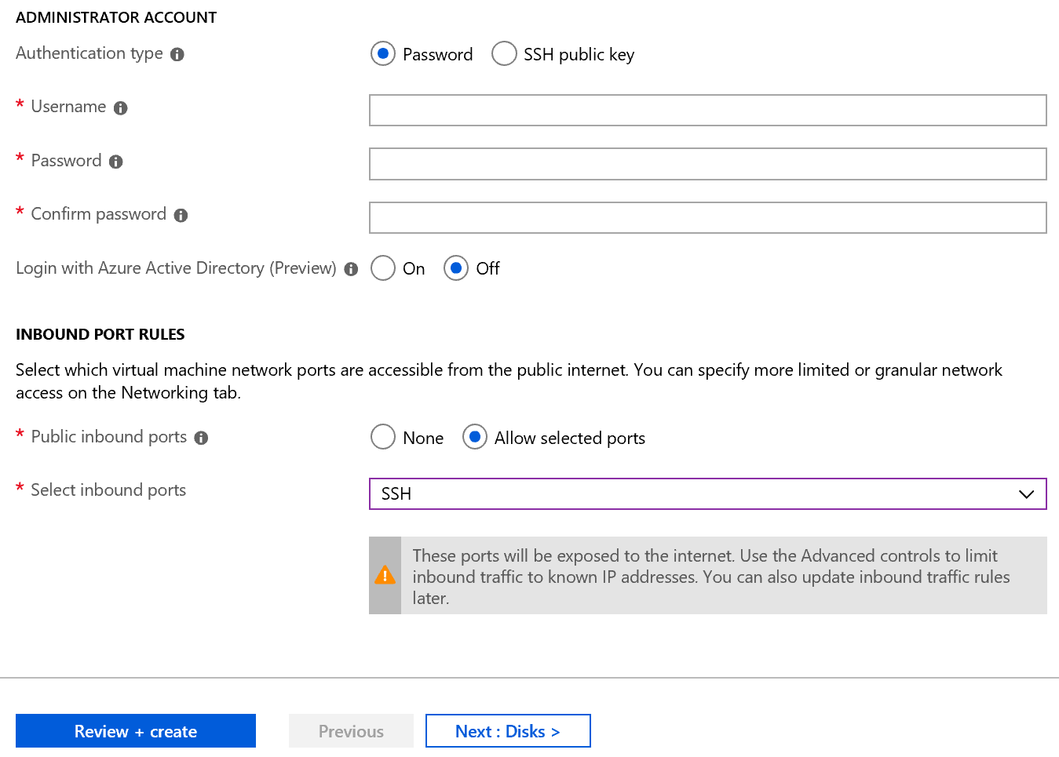
Create Linux Virtual Machine 1/4

Slide 22
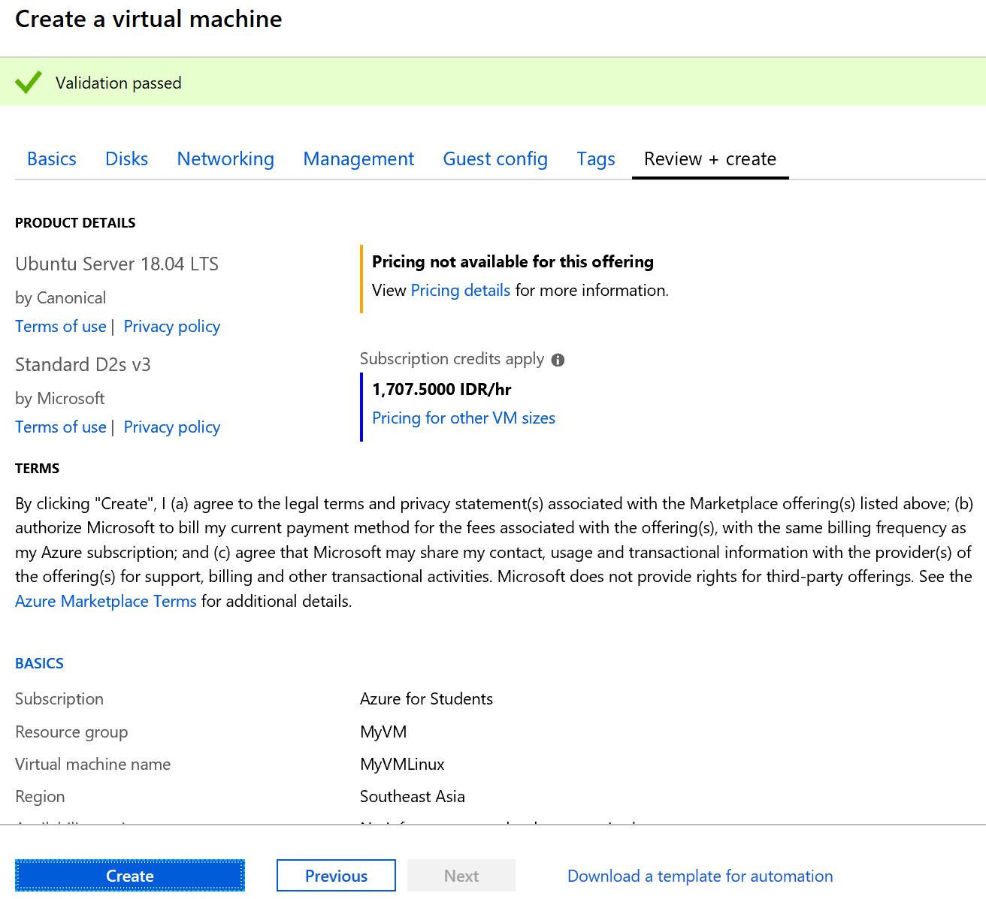
Create Linux Virtual Machine 2/4

Slide 23
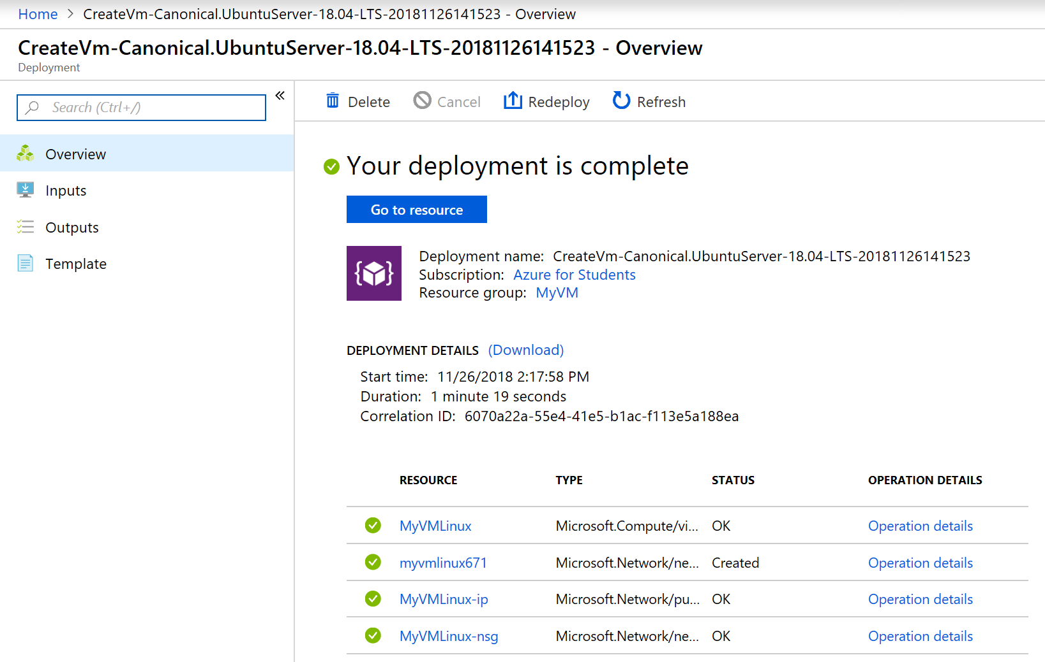
Create Linux Virtual Machine 3/4

Slide 24
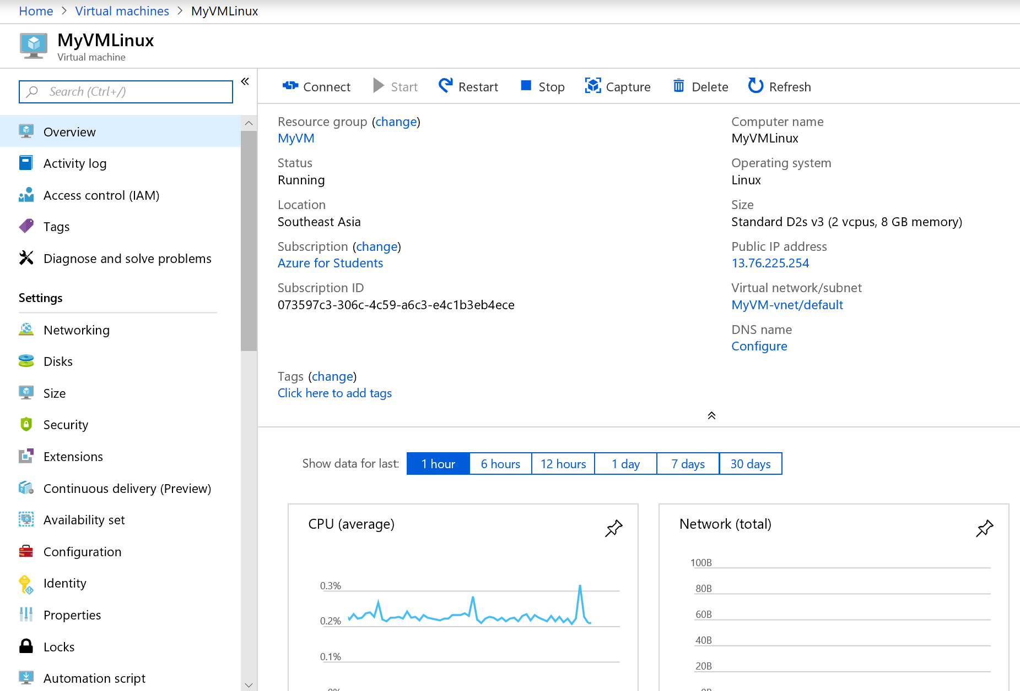
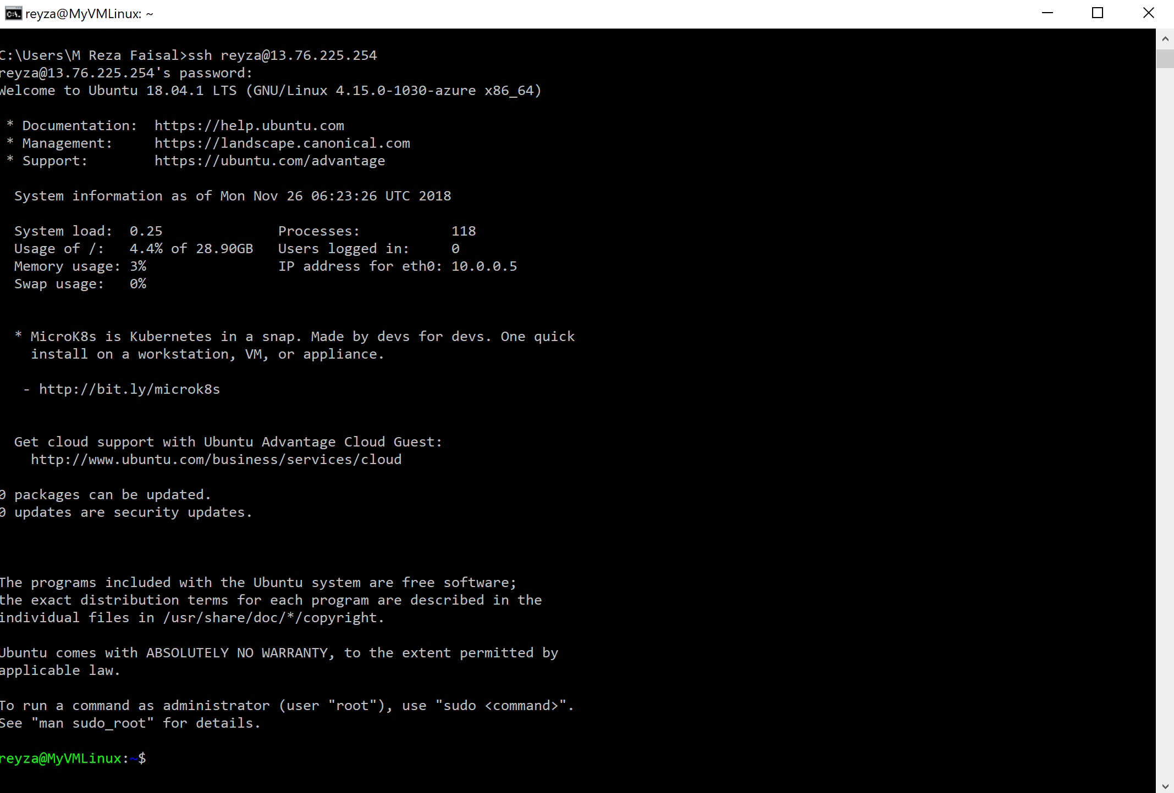
Create Linux Virtual Machine 4/4

